Slide 1
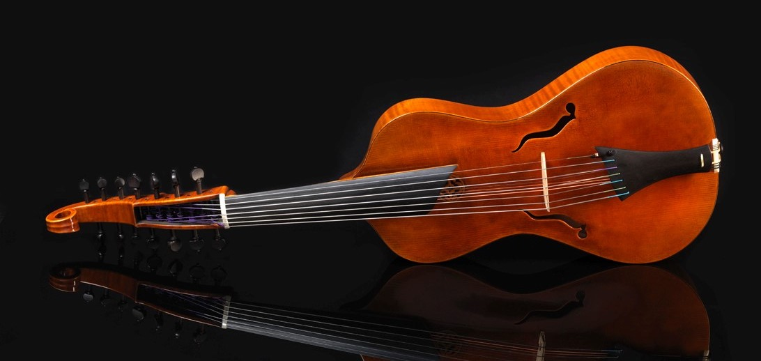
ViolA d’amorE 2.0
Contemporary composition for an instrument from the past
By Antonin Le Faure

Slide 2
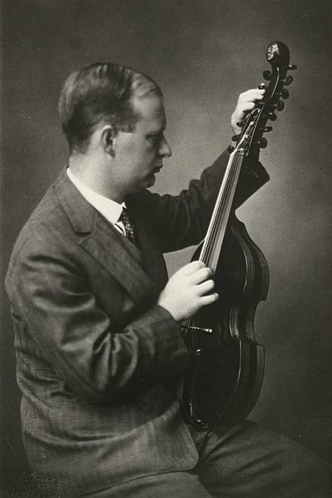
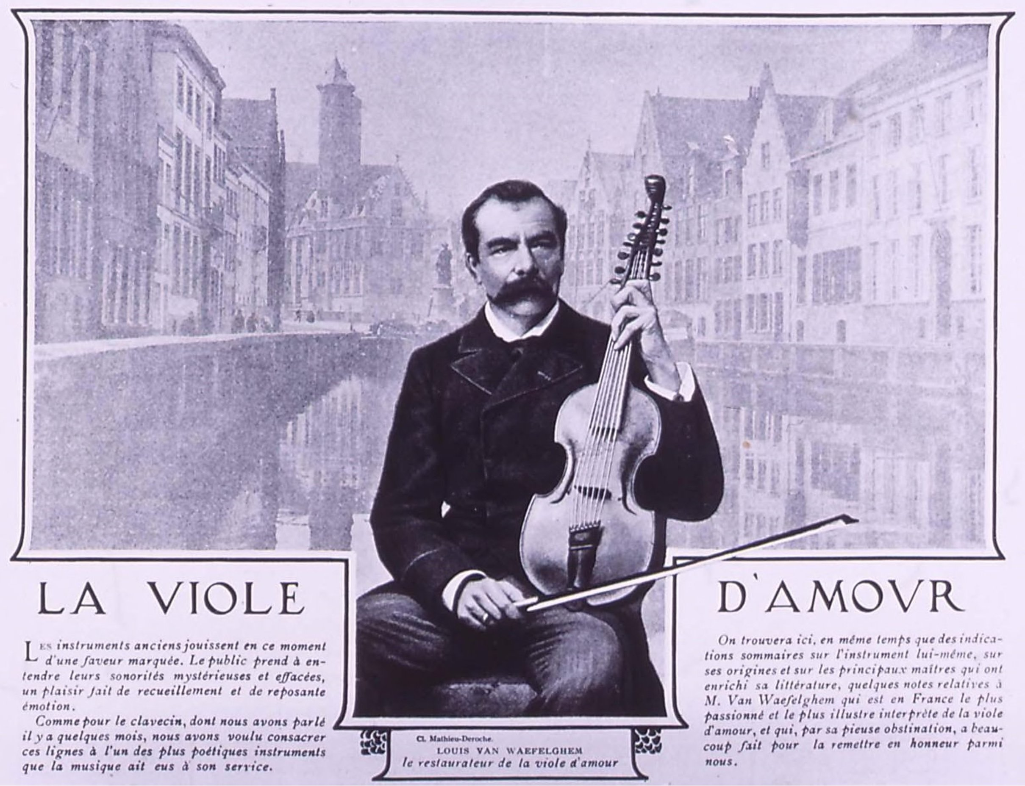
Introduction
Quick sight of viola d’amore composers of the twentieth century

Slide 3

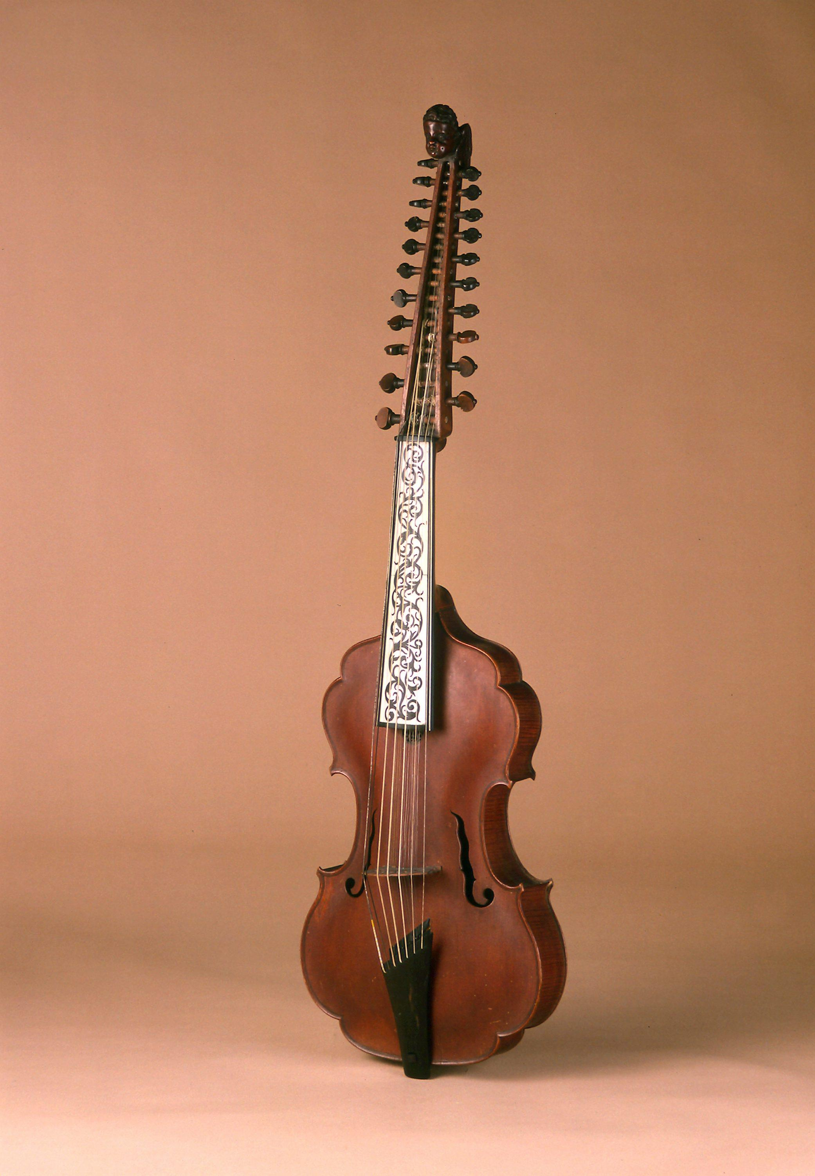
Le renouveau de la musique baroque
Hypothesis: electronic sound & baroque music
Nikolaus Harnoncourt: « “the beauty can be ugly, that is to say that for the requirements of the musical speech, it is sometimes preferable to seek an expression by the noise or a change of sound rather than by a beautiful sound. »
HARNONCOURT N., Le dialogue musical, Paris, Gallimard, 1985,
Georges Benjamin: « Writing for baroque instruments was strange at this time. After listening a gambist in my class, I became obsessed by this sound, sometimes close to indian traditional instruments, which inspired me a lot at those times. »
BENJAMIN G., Les règles du jeu : entretiens avec Éric Denut, Paris, Musica Falsa, 2004
VIOLA D’AMORE, GERMANY, 18E CENTURY

Slide 4

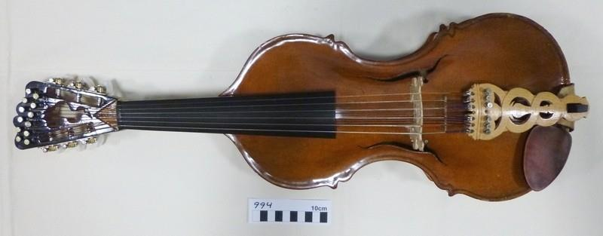
three examples of composition
Introduction
A. Schoenberg, 1924:
« The instruments whom have disappeared, as the viola d’amore, the oboe da caccia, the oboe d’amroe, the viola de gamba, the various types of lutes, the simple horn, the cornet and many others, owe their leur loss partly because they were less easy to play, partly because they couldn’t be improved. All those istruments had an endearing and original sound, but it couldn’t prevent them to sink. »
« How, for instance, could we still use a viola tuned up in D major, with which most of the keys are difficult, which compells the hand to go up in third position to give the ninth of the D in open string at E, which can only give the G-G octave if and only we press on two strings at normal step of tenth, which force the player, like with a lute, to pass a grat part of his life to look at what he is doing ? »
SCHOENBERG A., Style and Idea, Philosophical Library, New York, 1950
VIOLE D’AMOUR AU DESIGN DE S. MONTAGU CLEEVE, 1967-68

Slide 5

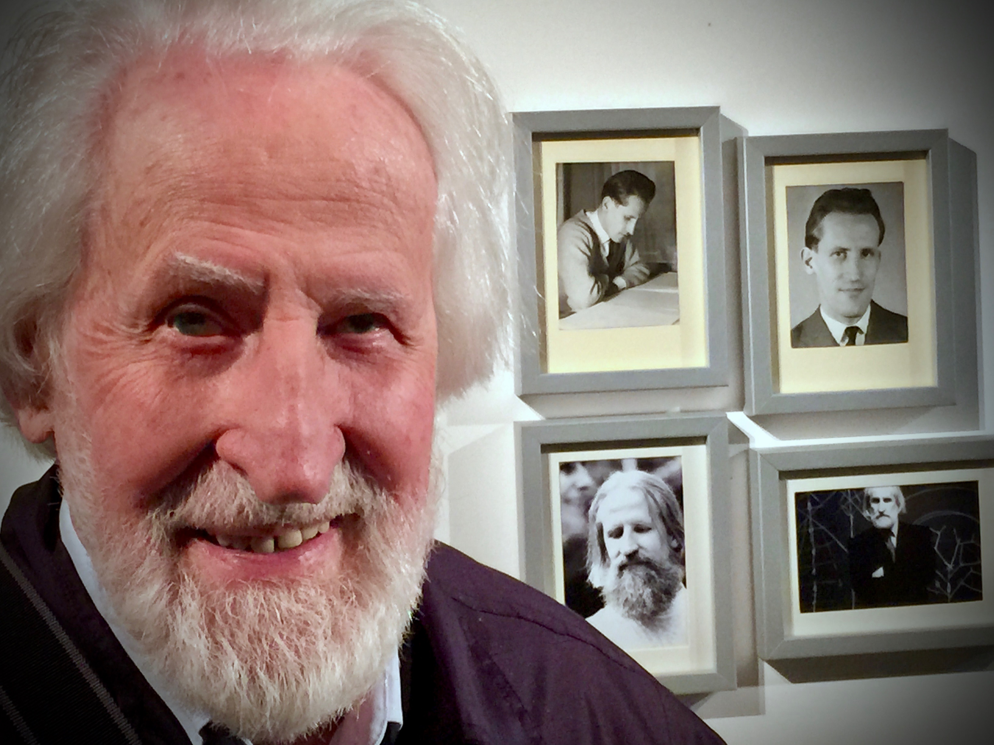
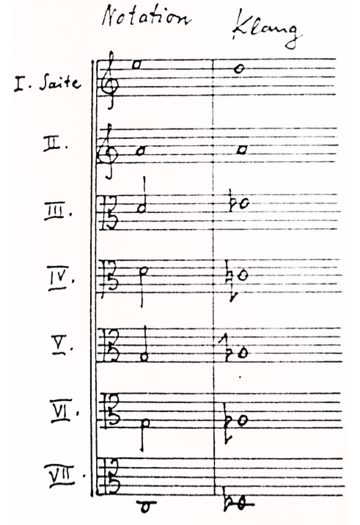
three examples of composition
Klaus Huber, ...Plainte...pour viole d’amour seule
Klaus Huber (1924–2019) : « the instruments are not auxiliary or passive ; they help to shape what the music is really. »
HUBER K., Au nom des opprimés : écrits et entretiens, Genève, Editions Contrechamp ( 2012)
KLAUS HUBER, Paris 2014 photo A. Le Faure
EX. 1 - KLAUS HUBER, ...PLAINTE... : ACCORDATURA WITH THE DIGITAL "FICTITIOUS" PART AND THE "REAL" PART AS HEARD

Slide 6

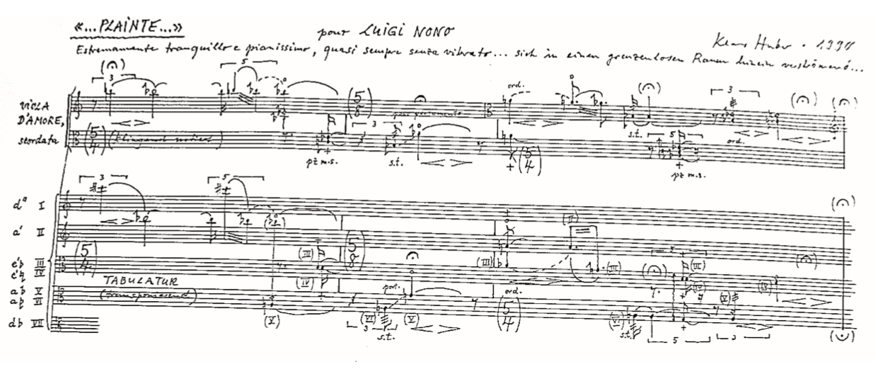
three examples of composition
Klaus Huber, ...Plainte...pour viole d’amour seule
EX. 2 - KLAUS HUBER, ...PLAINTE...: PRESENTATION OF THE TABLATURE (DÉBUT)

Slide 7

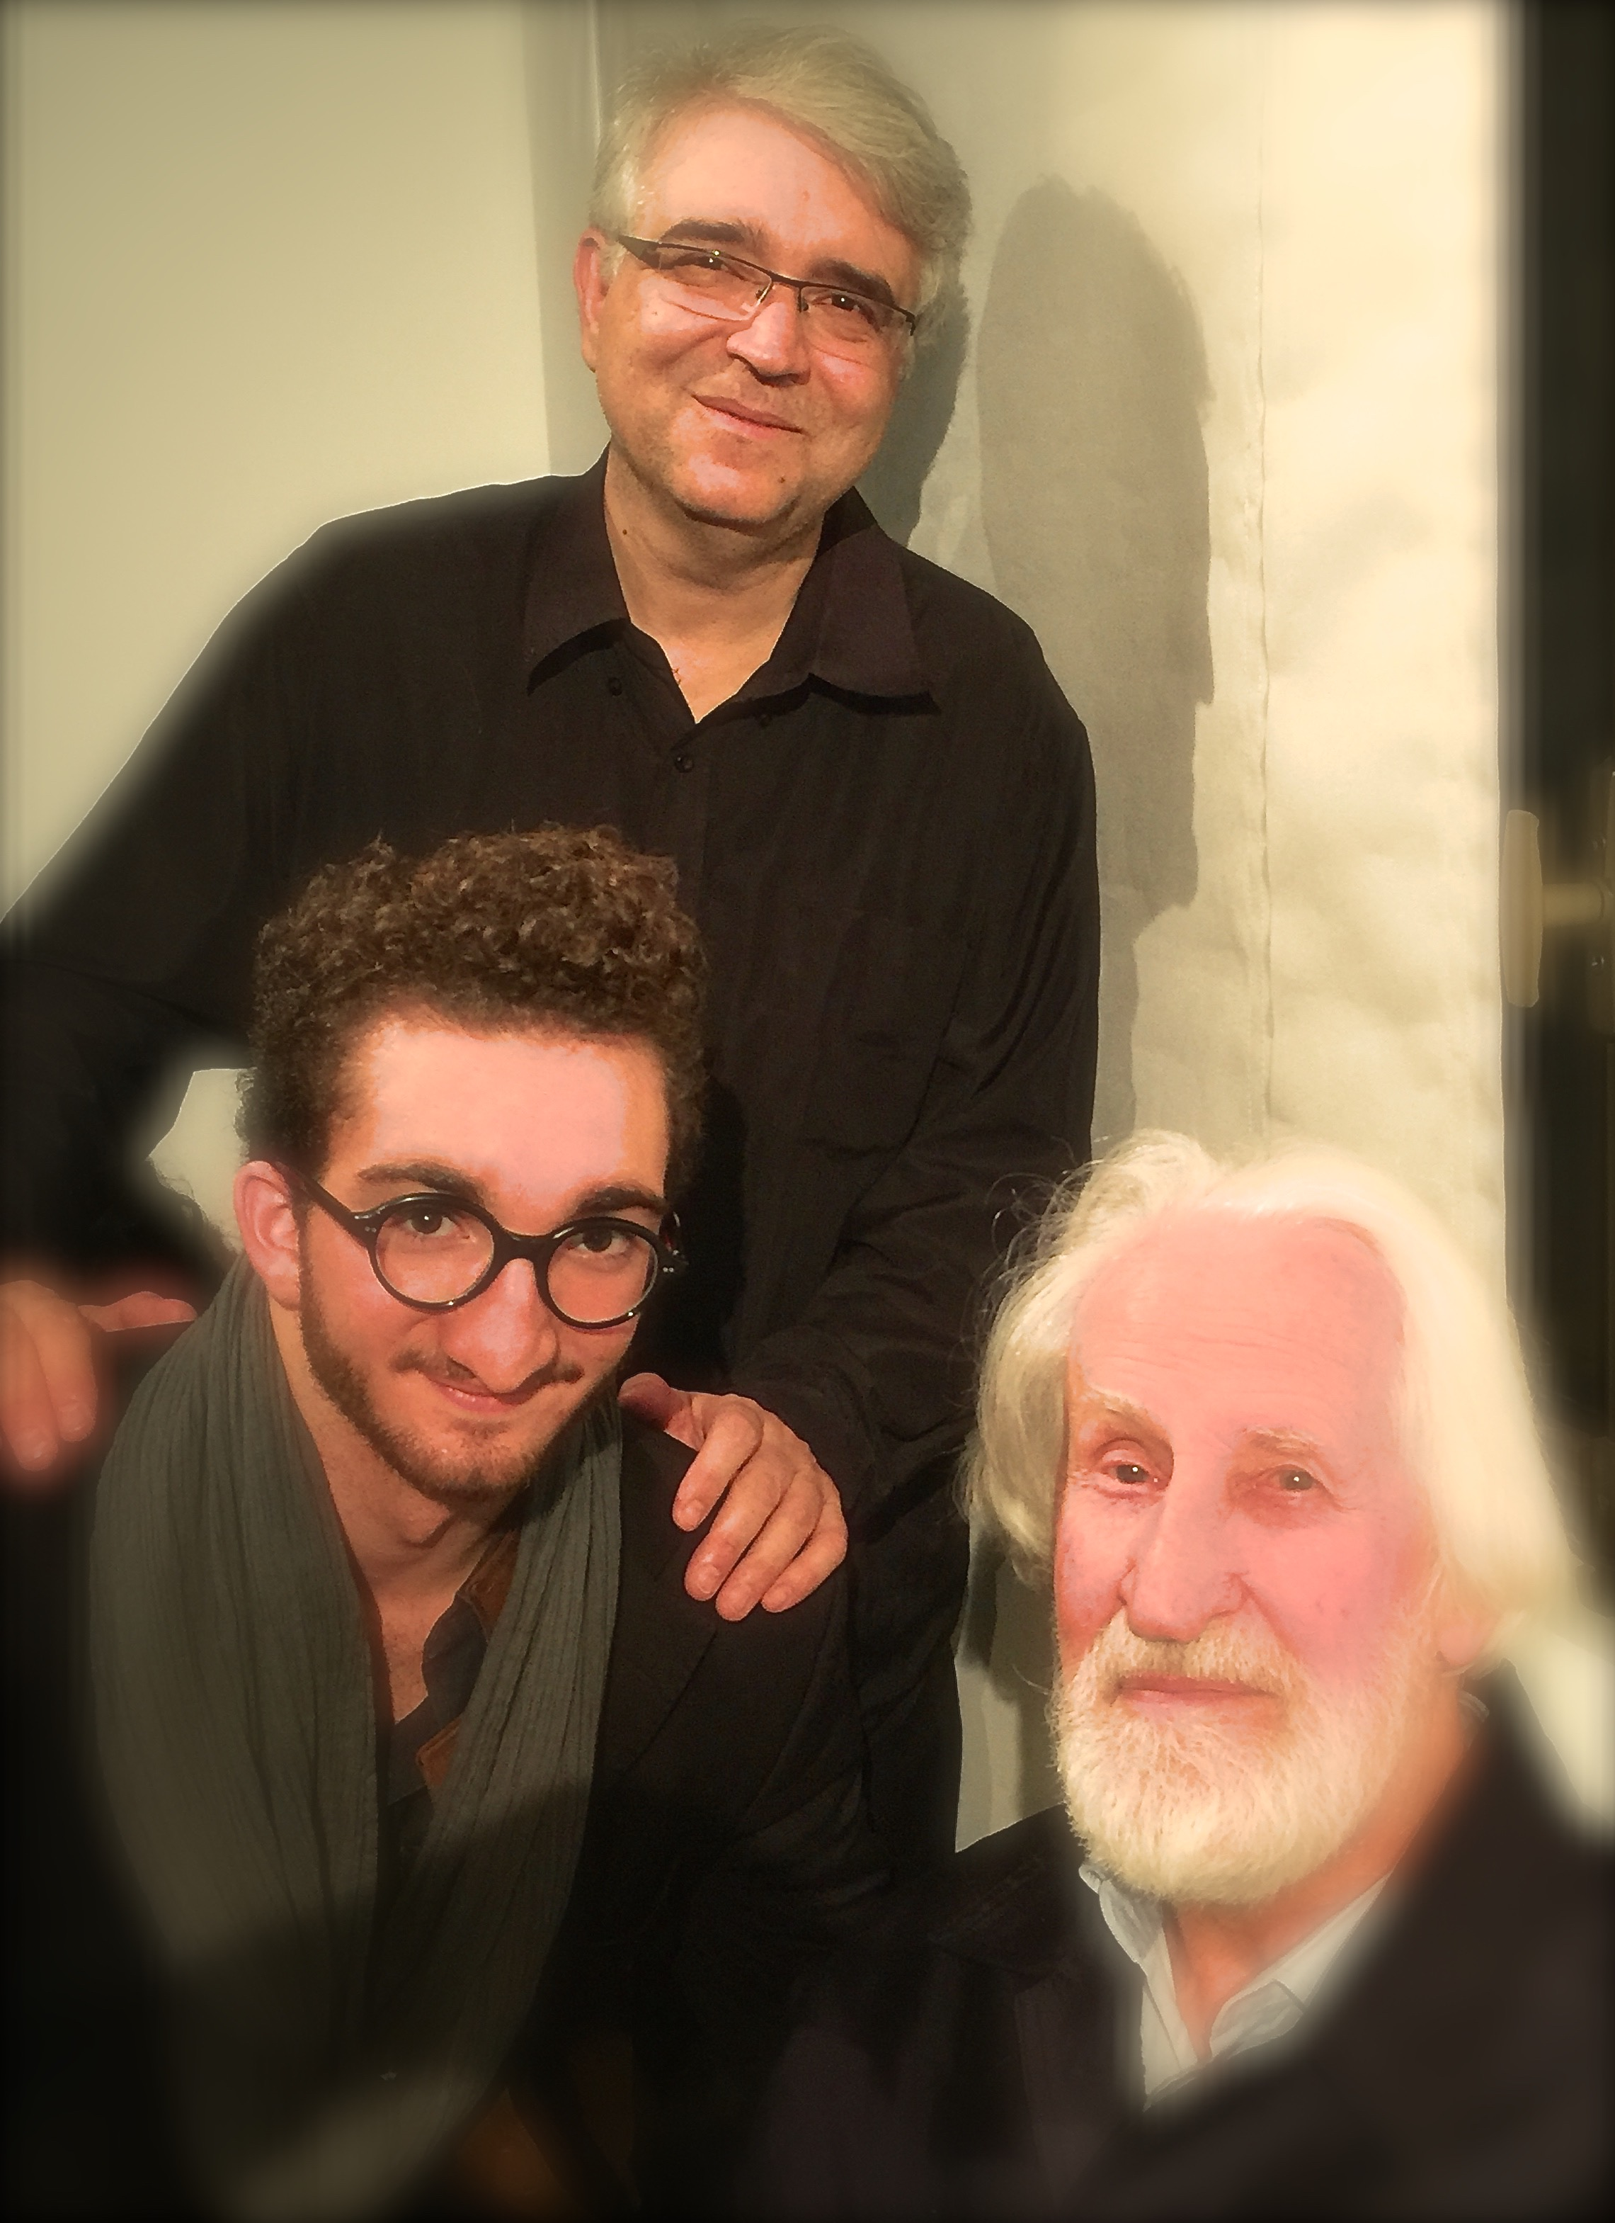
three examples of composition
Klaus Huber, ...Plainte...pour viole d’amour seule
audio excerpt
https://youtu.be/eAo5EpUcmP4
KLAUS HUBER, PIERRE HENRI XUEREB, ANTONIN LE FAURE, Paris 2014

Slide 8

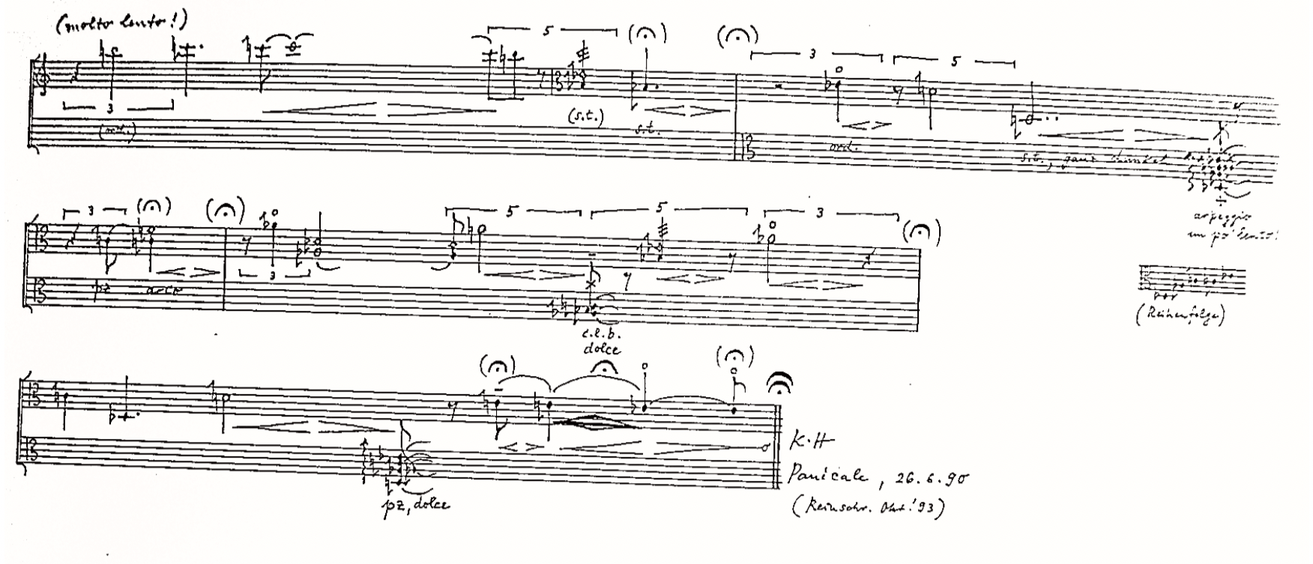
three examples of composition
Klaus Huber, ...Plainte...pour viole d’amour seule
EX. 3 - KLAUS HUBER, ...PLAINTE...: HALO ENVELOPING THE LONG NOTESN (FIN)

Slide 9

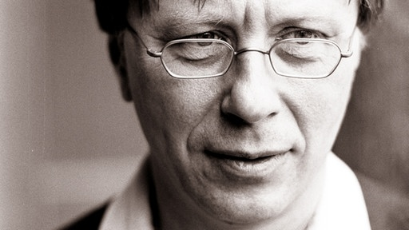
three examples of composition
Georg Friedrich Haas, Solo für Viola d’amore
audio excerpt
https://youtu.be/T1cyOzThYXI
Georg Friedrich Haas (1953- )

Slide 10

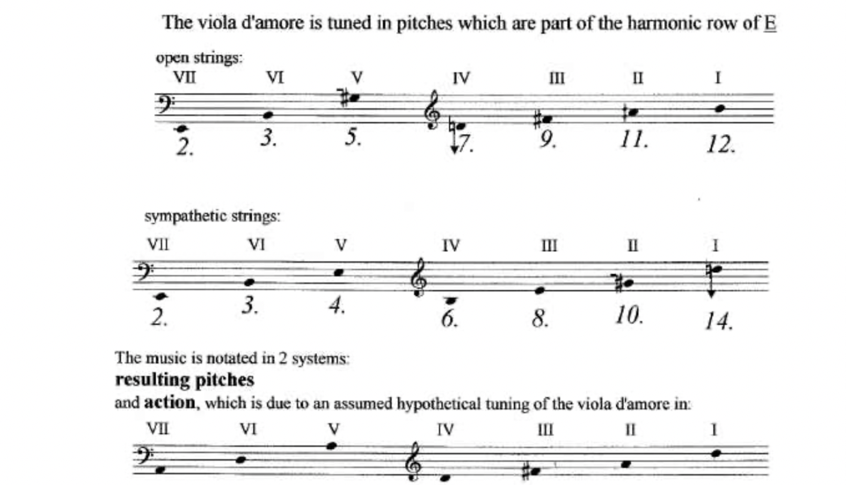
three examples of composition
Georg Friedrich Haas, Solo für Viola d’amore
EX 4 G. F. HAAS, SOLO FÜR VIOLA D’AMORE : ACCORDATURA & CHORD SYSTEM

Slide 11

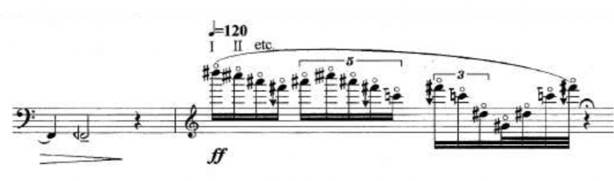
three examples of composition
Georg Friedrich Haas, Solo für Viola d’amore
EX 5 G. F. HAAS, SOLO FÜR VIOLA D’AMORE : FLAGEOLET HARMONICS ARPEGGIO(LIGNE 11)

Slide 12

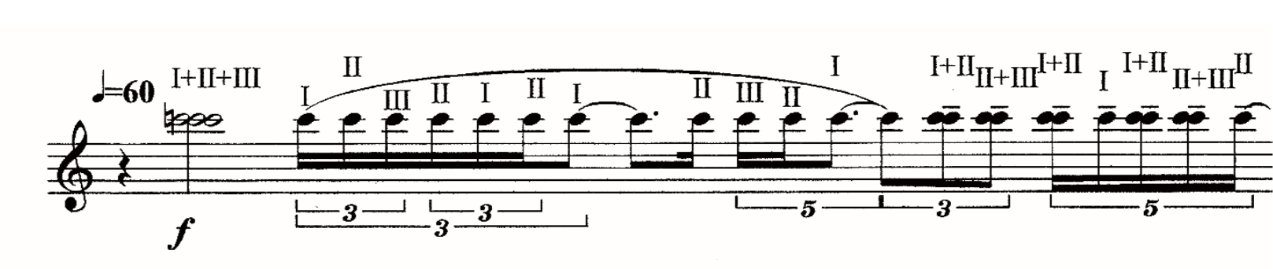
three examples of composition
Georg Friedrich Haas, Solo für Viola d’amore
EX 6 G. F. HAAS, SOLO FÜR VIOLA D’AMORE : PLAYING UNISON (LIGNE 25)

Slide 13

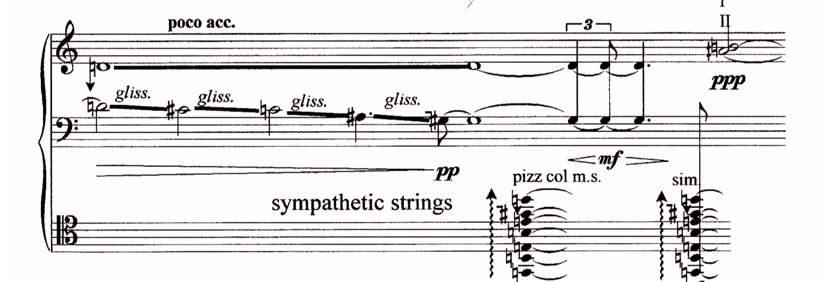
three examples of composition
Georg Friedrich Haas, Solo für Viola d’amore
EX 7 G. F. HAAS, SOLO FÜR VIOLA D’AMORE : LEFT HAND PIZZ ON RESONANCE STRINGS (LIGNE 45)

Slide 14

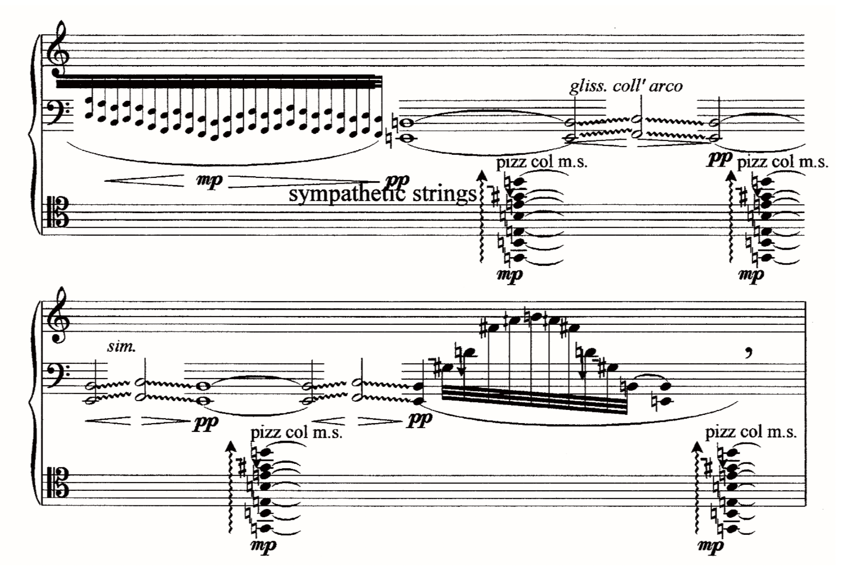
three examples of composition
Georg Friedrich Haas, Solo für Viola d’amore
EX 8 G. F. HAAS, SOLO FÜR VIOLA D’AMORE : LEFT HAND PIZZ ON RESONANCE STRINGS (LIGNE 68)

Slide 15

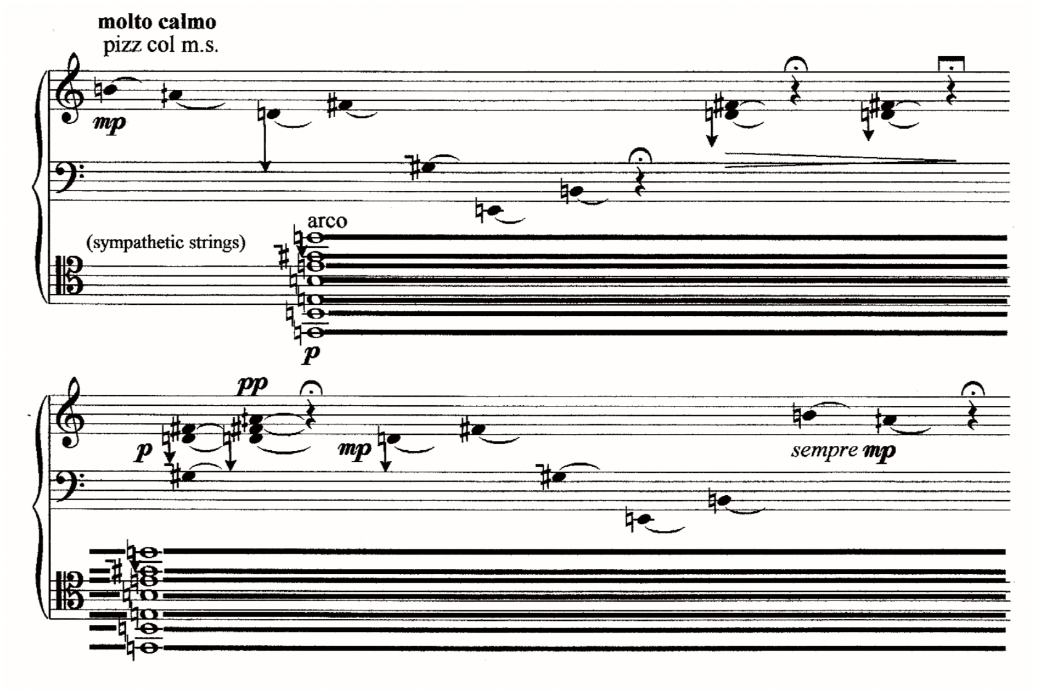
three examples of composition
Georg Friedrich Haas, Solo für Viola d’amore
EX 9 G. F. HAAS, SOLO FÜR VIOLA D’AMORE : TO PLAY ARCO ON THE RESONANCE STRINGS & LEFT HAND PIZZICATO (LIGNE 70)

Slide 16

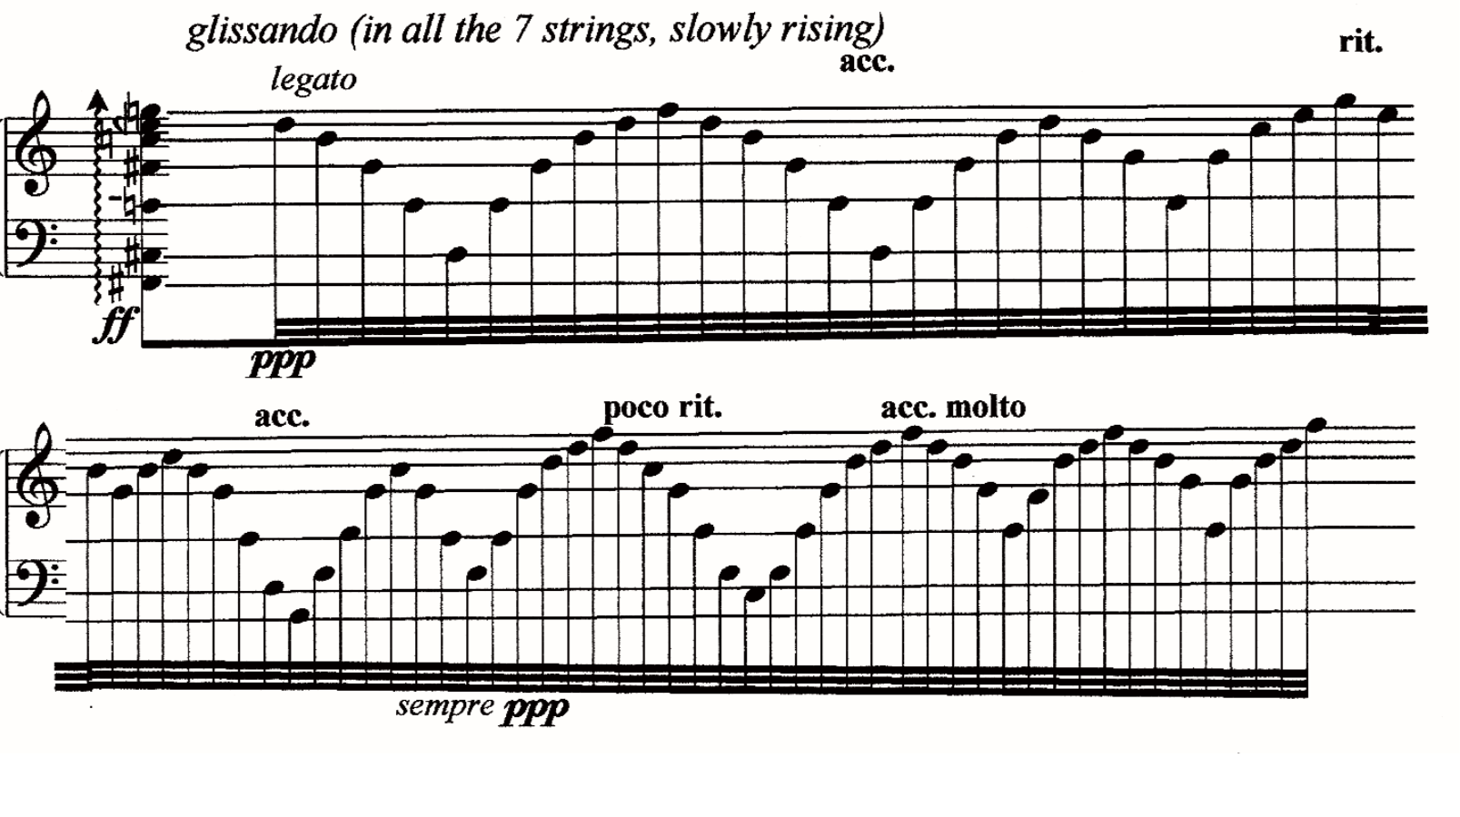
three examples of composition
Georg Friedrich Haas, Solo für Viola d’amore
EX 10 G. F. HAAS, SOLO FÜR VIOLA D’AMORE : GLISSANDI OF CHORDS ON ALL THE STRINGS

Slide 17

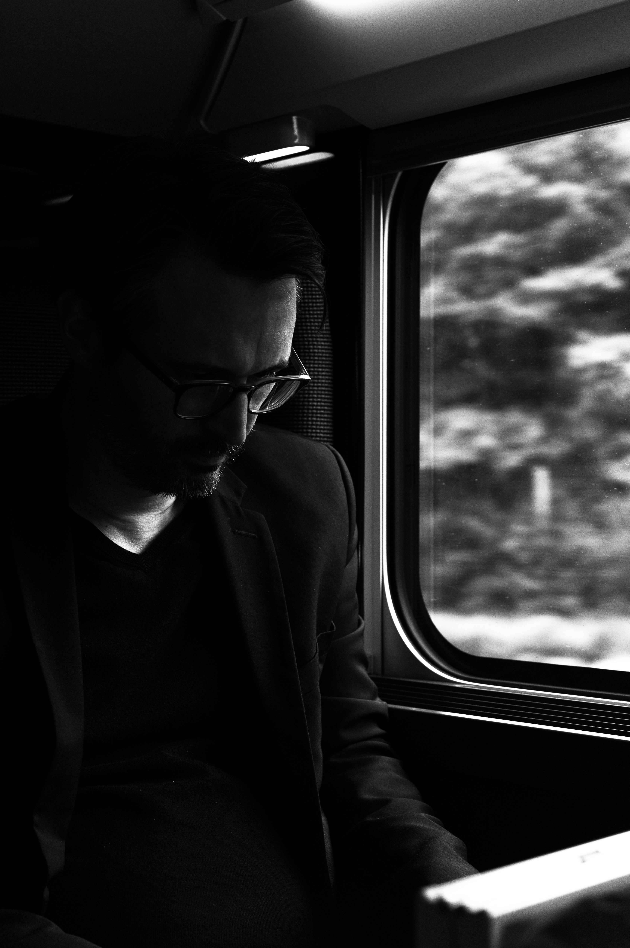
three examples of composition
Grégoire Lorieux , L’esprit d'amour (2001) pour soprano et viole d'amour amplifiée
audio excerpt
https://soundcloud.com/gr-goire-lorieux/lesprit-damour?utm_source=mobi&utm_campaign=social_sharing&utm_terms=mobi_google_one_tap.treatment
Grégoire Lorieux (1976- )

Slide 18

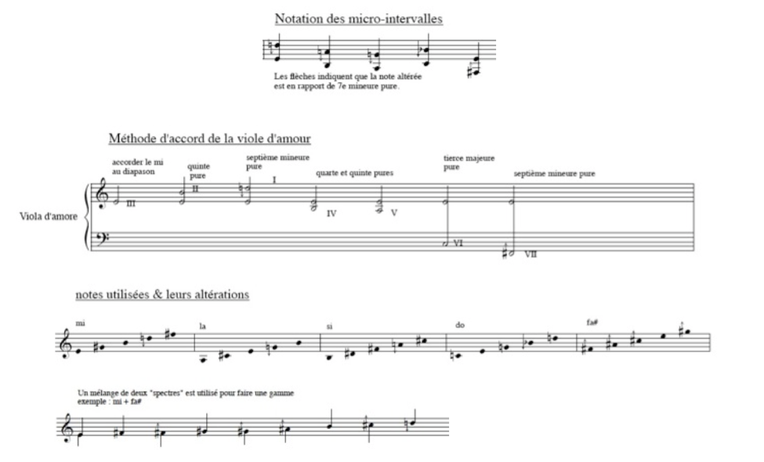
three examples of composition
Grégoire Lorieux , L’esprit d'amour (2001) pour soprano et viole d'amour amplifiée
EX 11 : G. LORIEUX, L’ESPRIT D’AMOUR : ACCORDATURA & CHORD SYSTEMA

Slide 19
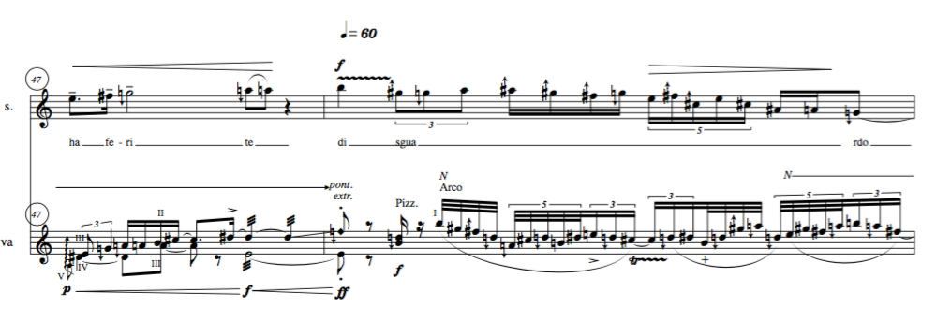
three examples of composition
Grégoire Lorieux , L’esprit d'amour (2001) pour soprano et viole d'amour amplifiée
EX 12 : G. LORIEUX, L’ESPRIT D’AMOUR : MES 47-48

Slide 20

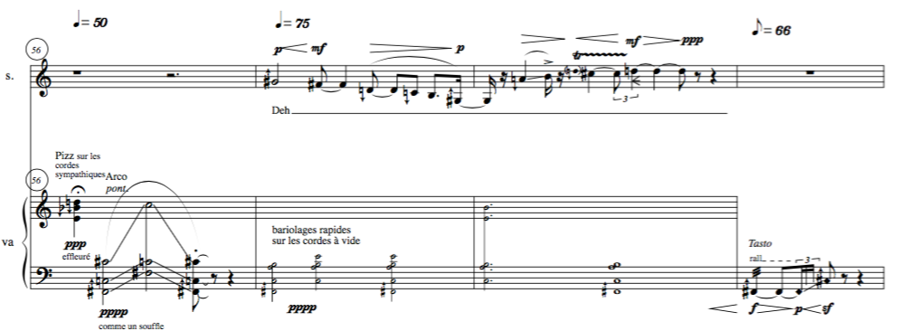
three examples of composition
Grégoire Lorieux , L’esprit d'amour (2001) pour soprano et viole d'amour amplifiée
EX 13 : G. LORIEUX, L’ESPRIT D’AMOUR : MES 56-59

Slide 21

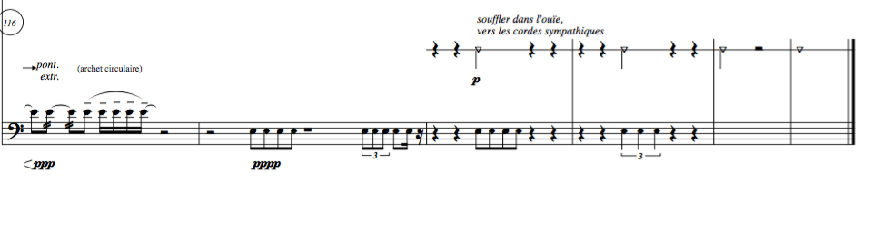
three examples of composition
Grégoire Lorieux , L’esprit d'amour (2001) pour soprano et viole d'amour amplifiée
EX 14: G. LORIEUX, L’ESPRIT D’AMOUR : MES 116-121

Slide 22

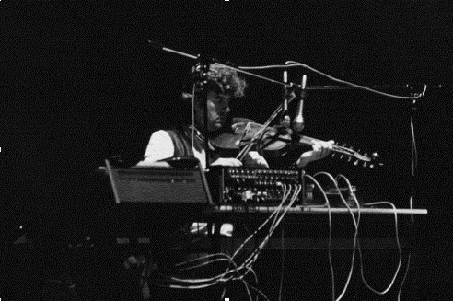
Other aesthetics
Experimental music
Johannes Fritsch

Slide 23

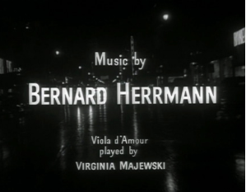
Other aesthetics
film music
Bernard Hermann

Slide 24

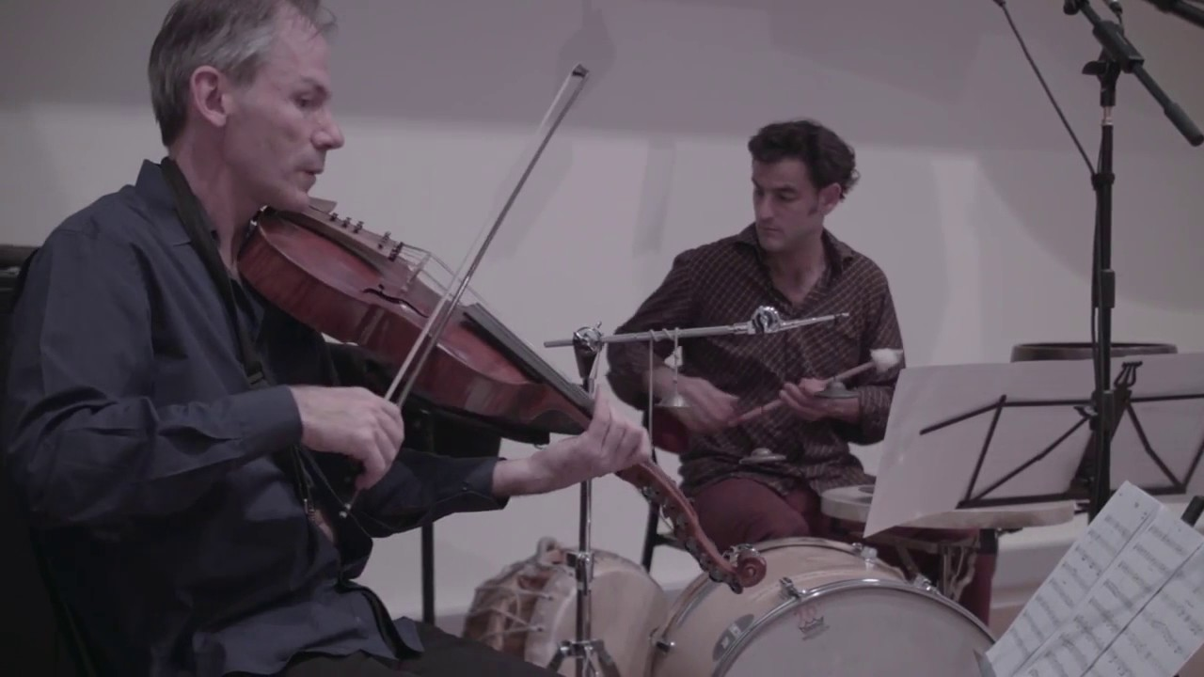
Other aesthetics
Jazz Avant-garde
John Zorn
Garth Knox & Saltarello Trio play John Zorn
« Leonard : Book of Angels Volume 30 »

Slide 25

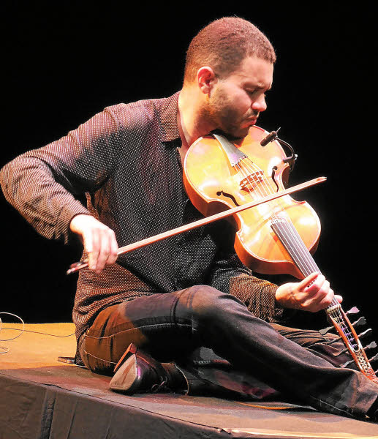
Other aesthetics
World Music
Jasser Haj Youssef

Slide 26

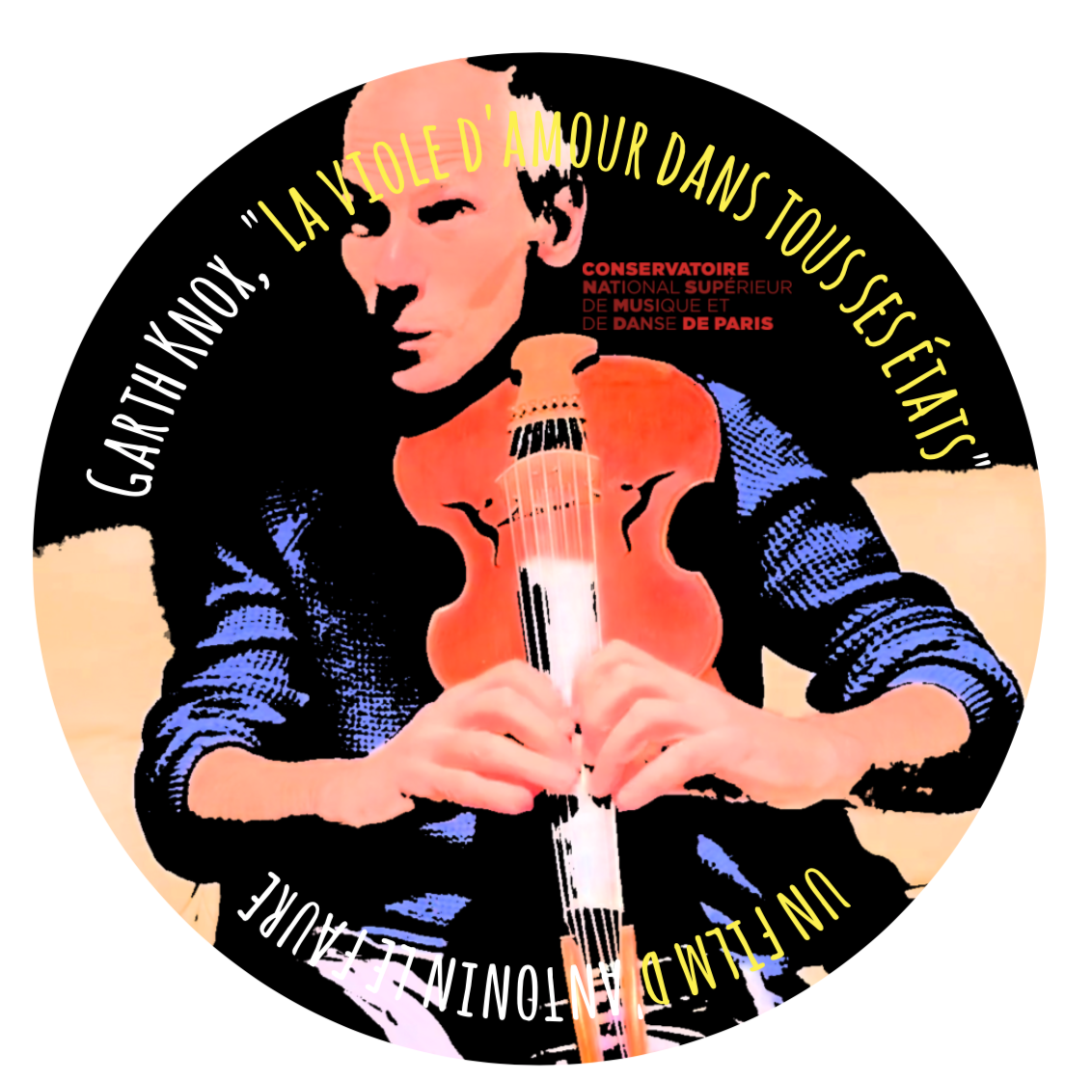
CONCLUSION
Work in progress
to pay homage to those - composers, performers, professors, stringed instrument makers - who defend this beautiful instrument.
Merci donc …à vous tous !

